Slide 1
Why a better conversation is important?
Sue Denmark, Co-Production member, Coalition for Collaborative Care (C4CC)
My health coaching story and why it matters
Dr Penny Newman, MD NCHC, NHS Innovation Accelerator (NIA) Fellow
My health coaching story, the evidence and film premier

Slide 2
“I believe the 21st century needs a new ambition, to develop not talk but conversation, which does change people. Real conversation catches fire. It involves more than sending and receiving information”
Theodore Zeldin, How talk can change our lives
↓

Slide 3
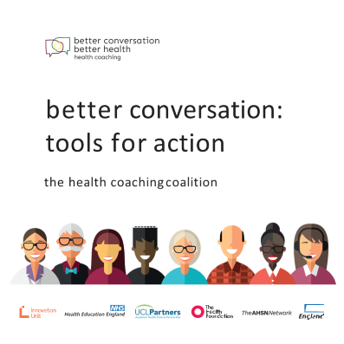
What's the problem?
The cost of diabetes treatment up from £9.8 billion to £16.9 billion by 2040, 17% of entire NHS budget vs about 10% today
The cost of treating diabetes complications (including kidney failure, nerve damage, stroke, blindness and amputation) will almost double from £7.7 billion currently to £13.5 billion by 2035/36
Diabetes threatens to 'bankrupt' NHS within a generation, 2012 https://www.theguardian.com/society/2012/apr/25/diabetes-treatment-bankrupt-nhs-generation

Slide 4

Am I being effective?

Slide 5

When patients see a clinician, their consultation may not be working
Only a third to a half of patients comply with prescribed medications and 10% with lifestyle advice
Only 60% of patients feel they are sufficiently involved in their care
Clinicians are not trained in behaviour change
Alignment between what patients want and what is provided is poor - goals, treatment choices, shared decision making
Poor communication leads to complaints
Paternalism breeds dependency
Bennett H, Coleman E, Parry C, Bodenheimer, 2010
KPMG Creating value with patients, carers and communities 2014
GMC Annual report 2013,
Rhoades DR, Fam Med 2001.
Wolever R, 2013
Coulter A, 2011
Notes:
And the evidence is growing our current approach with patients is not working – how we engage with them, talk with them and support them to change behaviour:
Half of patients leave primary care visits not understanding, only 9% of patients participate in decisions, adherence rates for medications and lifestyle changes are ~ 50% and 10% ,
Clinicians are not trained in the science of behaviour change based on the most recent research.
The goals of patients are not given enough recognition in treatment choices, and the benefits of shared decision making and patient and carer involvement are not being realized.
Basic communication needs to improve - research shows most Drs interrupt within 12 seconds. The #Hellomyname is campaign illustrates that we need o introduce ourselves
While on the whole satisfaction is high complaints are rsising. The GMC experienced 104% rise in complaints 2007-2012, with 54% about clinical care or communication.
This is because paternalism – being expert driven, authoritarian, and advice-giving “we know best” – while important when patients are acutely unwell, can encourage dependency, is not most effective in terms of behaviour change and patients do not always appreciate it.
We need to talk differently.

Slide 6
What is health coaching?
Helping patients gain the knowledge, skills, tools and confidence to become active participants in their care so that they can reach their self-identified health goals Bodenheimer, 2010

Slide 7
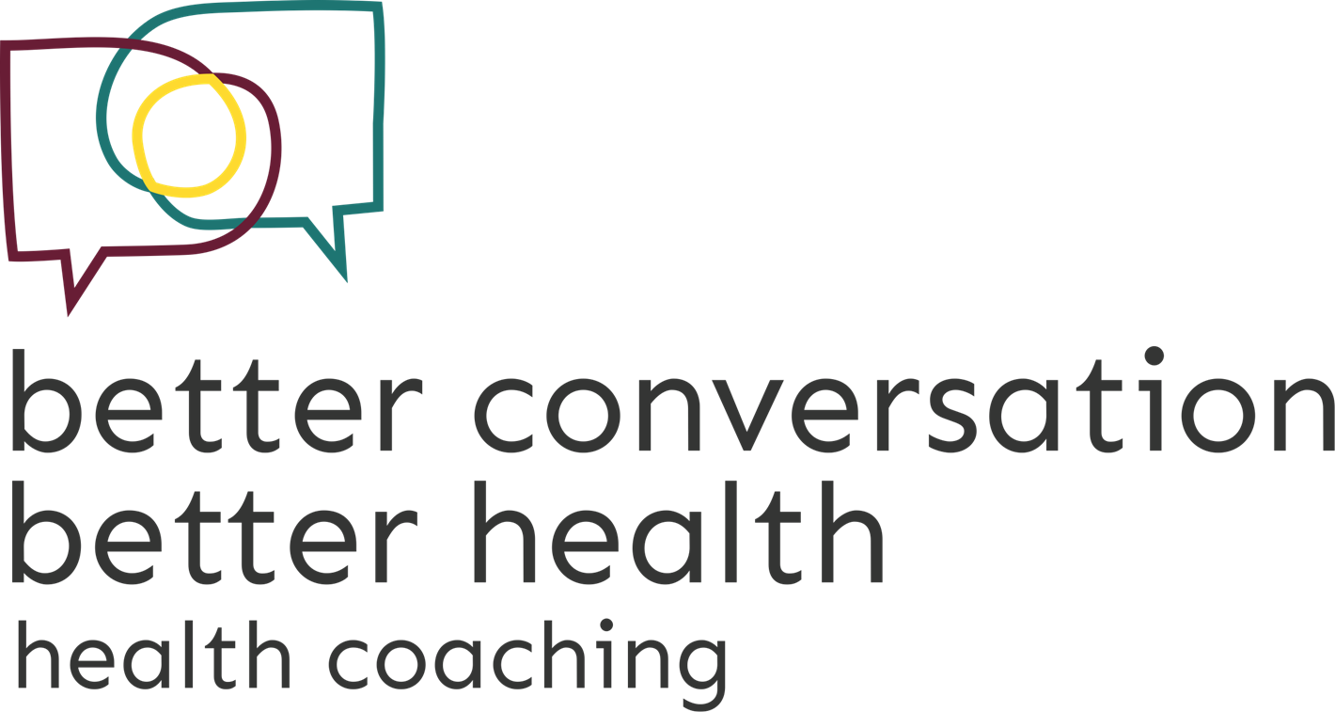
Health coaching development timeline
2010
Pilot
13 practice nurses in East of England
2013/14
Roll out
Nearly 800 clinicians and 20 local trainers across the region
2015/16
National scaling
NHS Innovation Accelerator
Resources, website and social movement
Collaboration 18 organisations
3,200 clinicians and others trained, 60 trainers
Policy influence

Slide 8
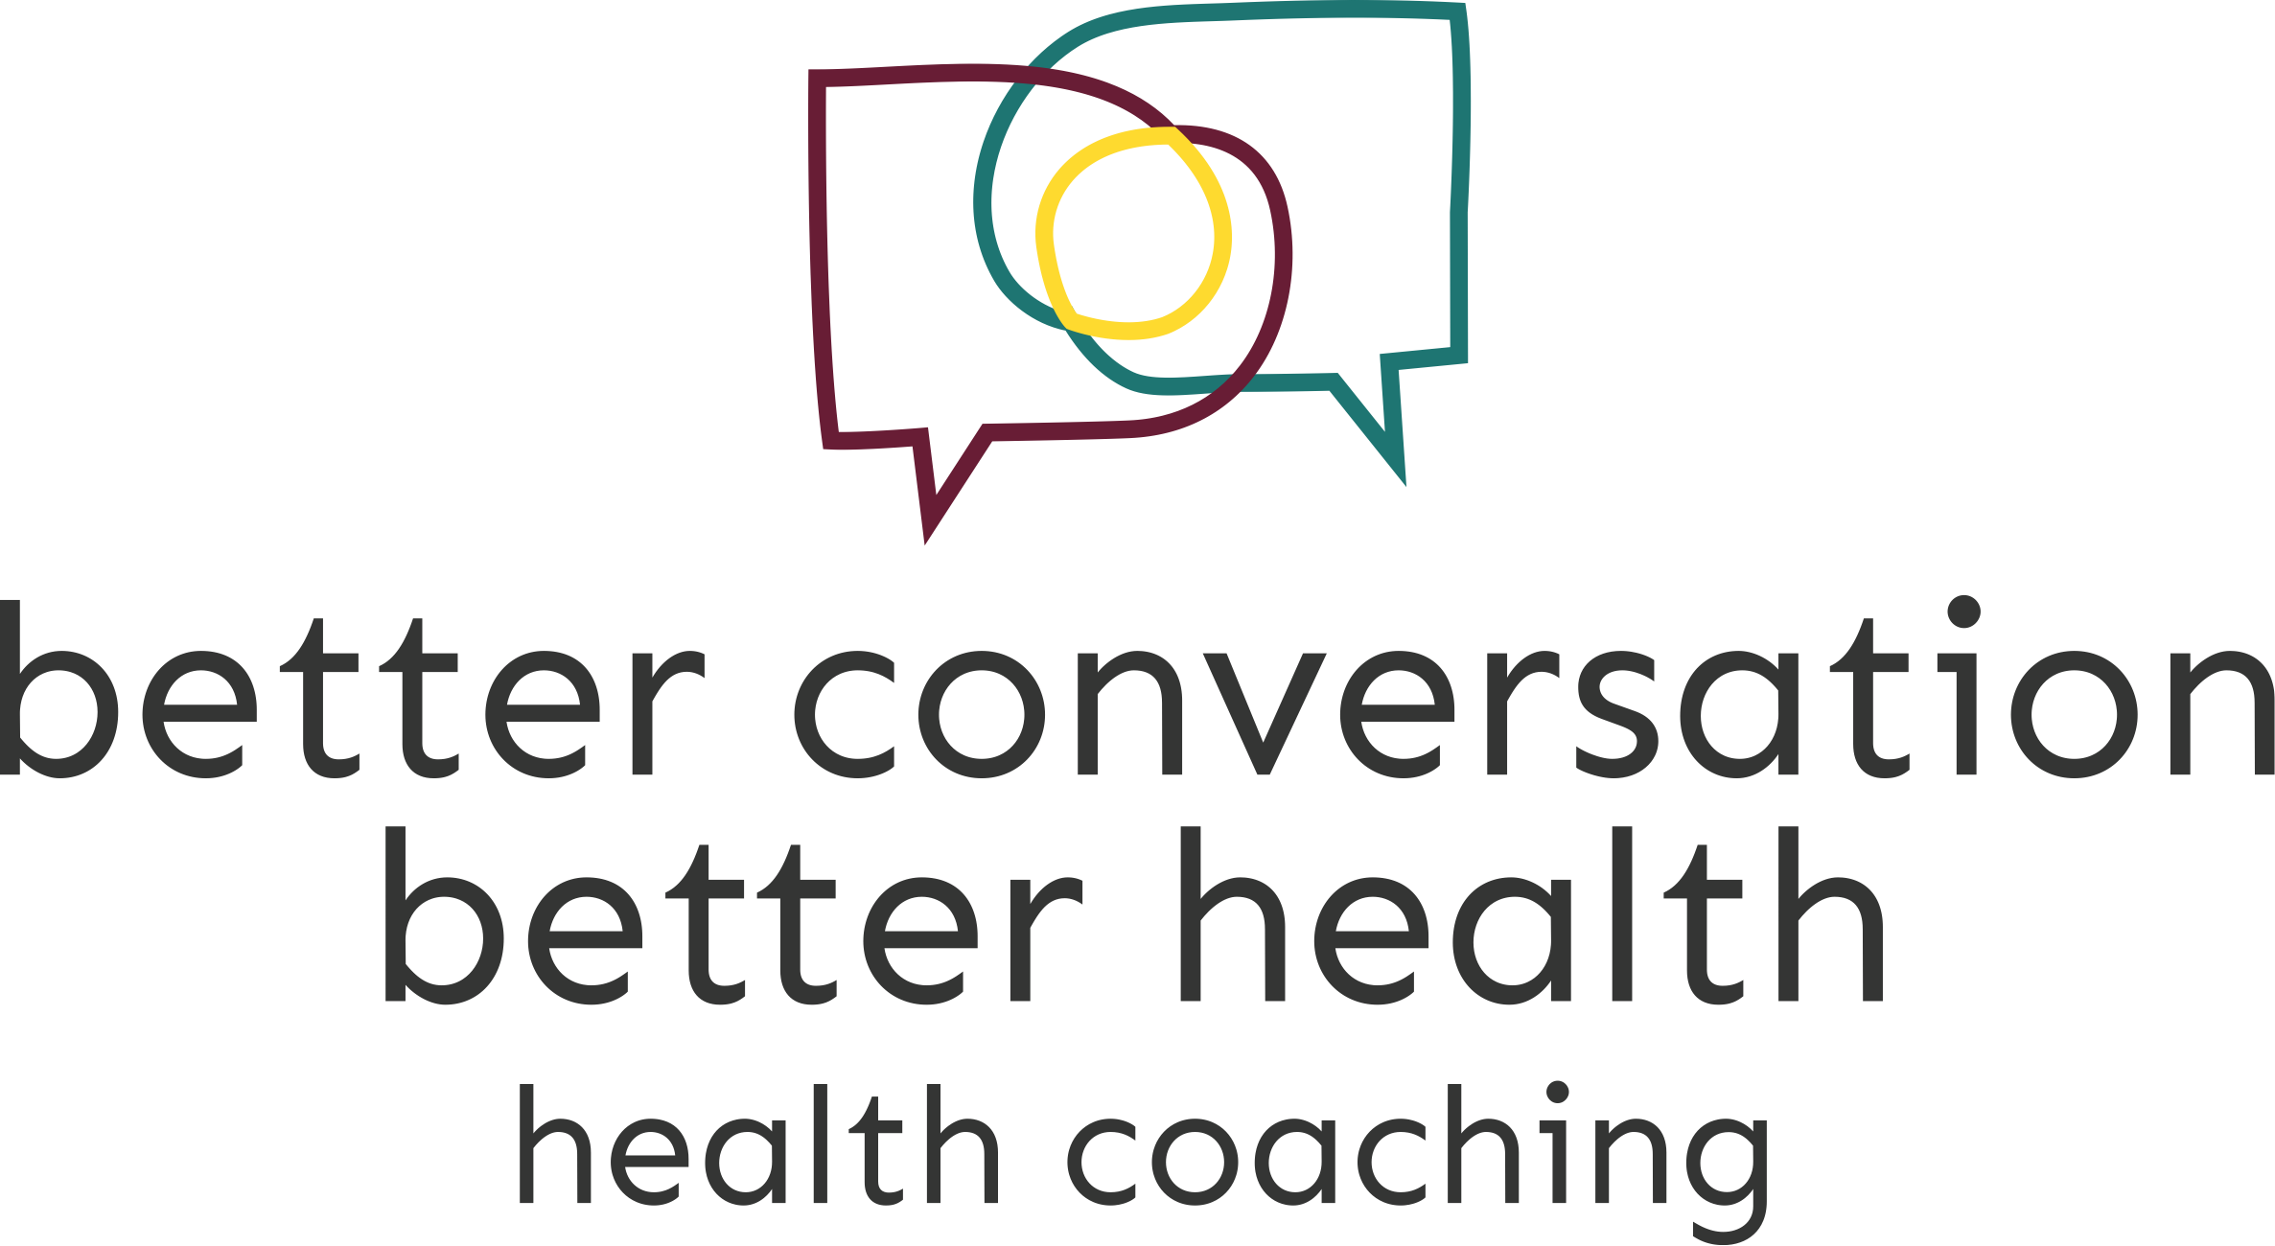
Training
Engaging
Growing a social movement
Co-creating

Slide 9
Growing evidence
Activates patients
Acts as bridge between clinicians and patients
Used in a wide range of conditions for different purposes
↑ motivation to self manage and adopt health behaviours
↑ self efficacy/activation
Effective with vulnerable groups
Activates clinicians
Can be used by all professionals (and peers)
Helps structure difficult conversations
Useful with colleagues e.g. in leadership role
Reported ↑ resilience and job satisfaction
Catalyses organisational change
Meet strategic priorities e.g. FYFV
Creates champions for self care
Cost-effectiveness/outcomes
Can impact on utilisation, costs and outcomes e.g. residential care placements, medication adherence, HbA1c/BP/cholesterol, readmissions – and these changes look sustainable
Needs more research
Spin offs
? Impact on complaints, errors, patient experience, clinician burn out
Needs standardising and more research

Slide 10
5 Year Forward View
- meets wellbeing, quality and efficiency gaps
Chapter 2
Radical upgrade in prevention - hard hitting national action on lifestyle/behavioural health risks
Empowering patients - support people to manage their own health
Chapter 3
New models of care - must be integrated and requires a psychologically minded workforce
Sustainability and Transformation Plans
Includes requirement for “empowering patients and communities”

Slide 11

The health coaching coalition
Our aim is to enable people to thrive by feeling more motivated, confident and in control of managing their own health and care
We believe great conversations can transform relationships and health behaviours to benefit patients, staff and the NHS

Slide 12
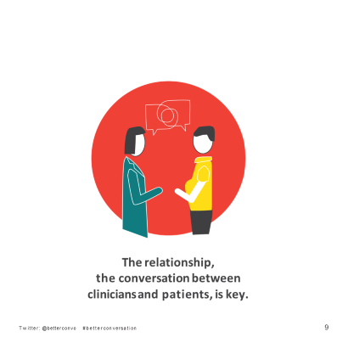
How can I join the movement for #betterconversation?
New resources available from 26th Sept
www.betterconversation.co.uk
Two launch events
Short film
Call to action booklet
A resource guide, prompts, case studies and evidence
Training materials
An online community
Use of brand
Join the coalition

Slide 13
Testimonial from Dr Ruth Q. Wolever, PhD Director of Vanderbilt Health Coaching, Associate Professor, Physical Medicine and Rehabilitation, Dept of Psychiatry Vanderbilt Schools of Medicine and Nursing
Despite its many problems the NHS is headed in a brilliant direction.
Physicians, nurses and allied health practitioners are frustrated with the burgeoning workload and seemingly less-engaged patients as the personal, social and financial impact of chronic disease rises. Patients feel dismissed, uncared for, and even blamed for challenging issues.
But the NHS recognizes one of the real problems - that providers do not have the right tools to be successful in helping patients engage in effective lifestyle change processes that are sustainable.
Rather than leaving providers with the outdated impression that they are supposed to educate patients and tell them what to do (exercise more, eat more fruits and vegetables, drink less, etc.), the NHS is training providers in health coaching skills based upon the latest science in how human motivation and successful behaviour change works. By doing this across large systems, they will reap the benefits of the rapidly growing science showing these processes empower patients to more effectively engage in partnerships to self-manage their lifestyles, promote health and mitigate chronic disease.
18th September 2016

